Slide 1
UNIT 1
Operations with Real Numbers

Slide 2
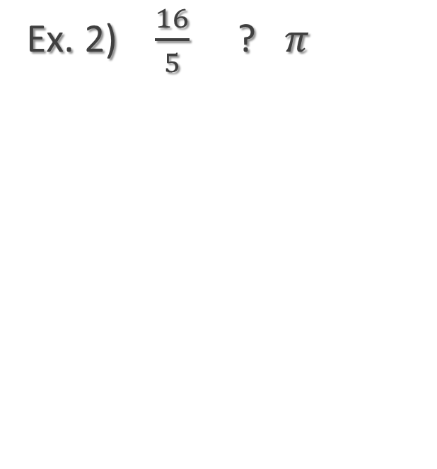


SELECT EITHER <, >, OR =
Ex. 1 ) $\sqrt{98}$ ? $\frac{55}{6}$
Ex. 2) $\frac{16}{5}$ ? $π$
Ex. 3) $\frac{π}{3}$ ? $1.04\overline{4}$

Slide 3
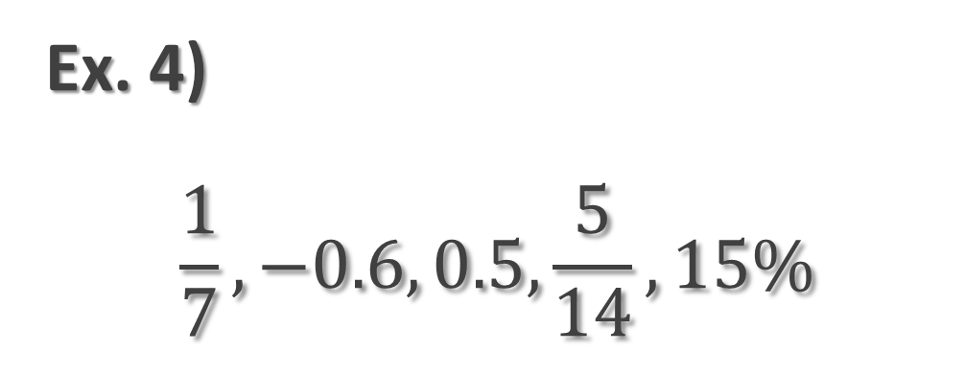
Compare and Order Least to Greatest
Ex. 4)
$$\frac{1}{7},−0.6, 0.5, \frac{5}{14},15\%$$
Change All Numbers into Decimals.
Compare.
Put in Order Using the Original Form.

Slide 4
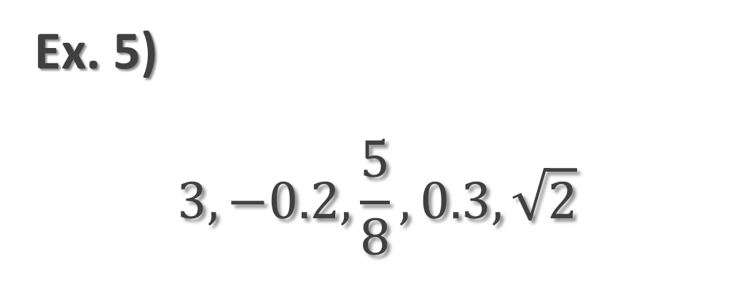
Compare and Order GREATEST TO LEAST
Ex. 5)
$$3,−0.2,\frac{5}{8},0.3,\sqrt{2}$$
Change All Numbers into Decimals.
Compare.
Put in Order Using the Original Form.

Slide 5
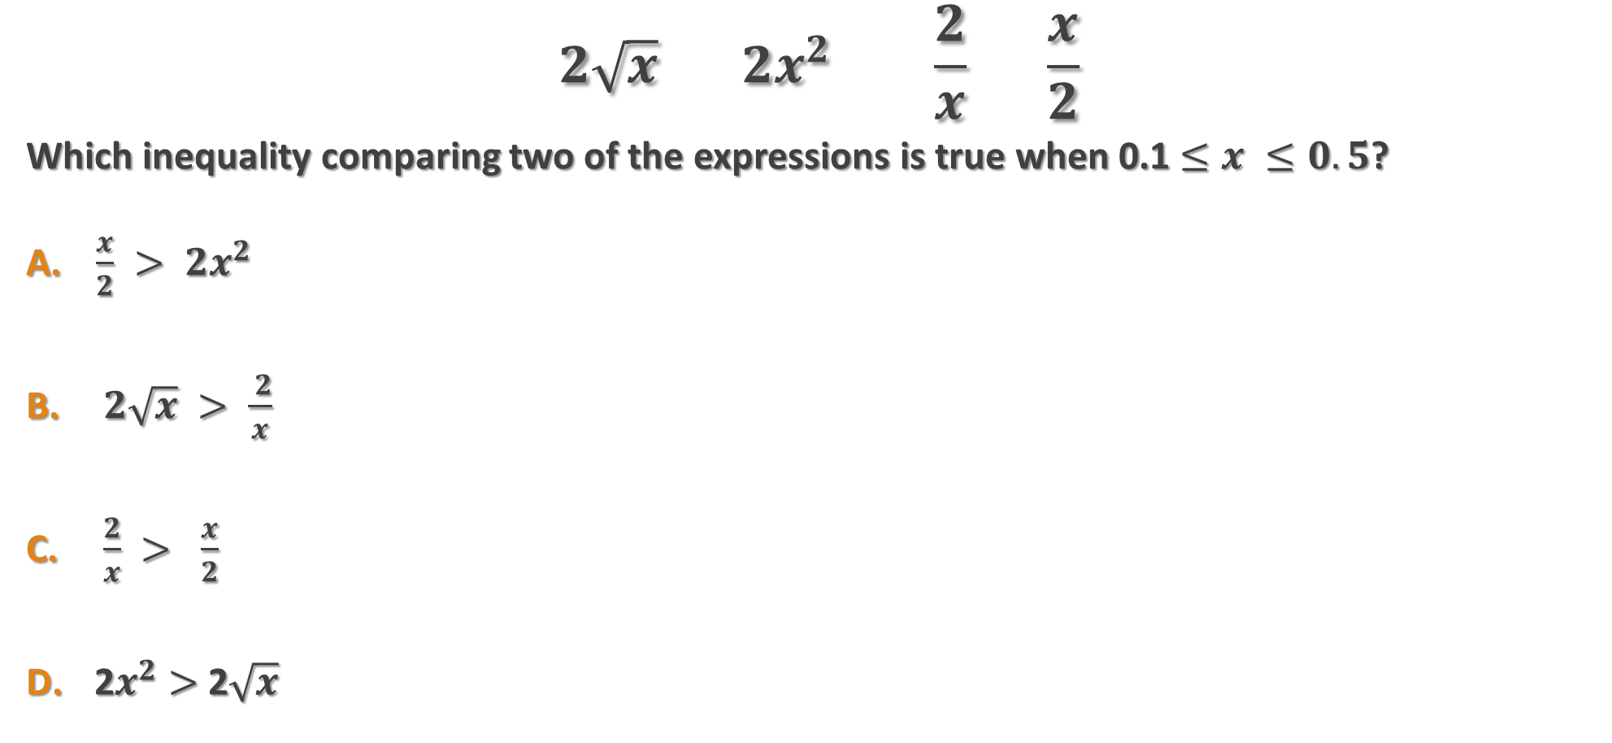
Ex. 6) Four expressions are shown below
$$2\sqrt{x} 2x^{2} \frac{2}{x} \frac{x}{2}$$
Which inequality comparing two of the expressions is true when 0.1 $≤x ≤0.5$?
$\frac{x}{2} > {2x}^{2}$
$2\sqrt{x} > \frac{ 2}{x}$
$\frac{2}{x} > \frac{x}{2}$
2$x^{2}>$2$\sqrt{x}$

Slide 6
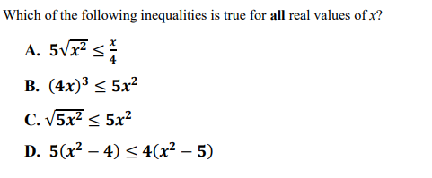
Ex. 7)

